Slide 1
ABC of
Hygiene

Slide 2
Introduction
Why is good hygiene important
Kids mix with each other, both in class and in play
Helping the child understand hygiene keeps the family healthy

Slide 3
What Parents/teachers should know
Vaccination alone cant prevent all infections
Good hygiene practices, like hand cleaning keeps infection at bay

Slide 4
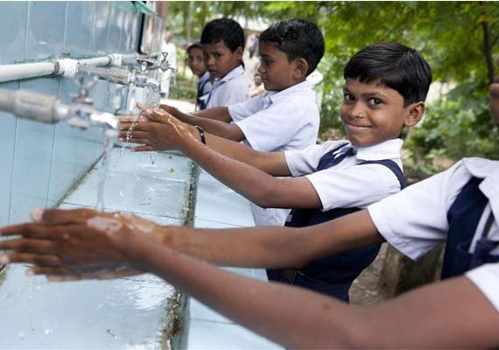
Hand Hygiene
Before
Eating or before feeding children
Applying contact lenses
After
Using the toilet or changing a childs nappy
Handling pets and domestic animals
Coughing, sneezing or blowing and scratching the nose

Slide 5
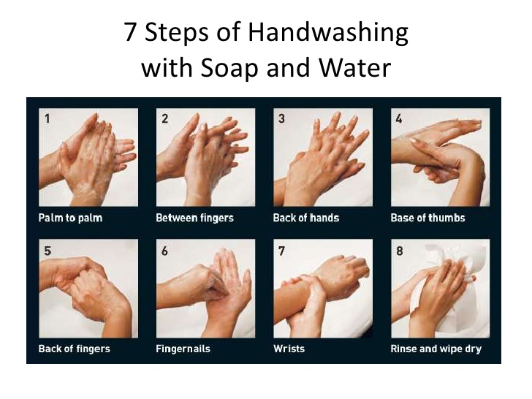

Slide 6
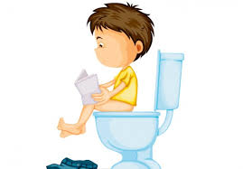
Toileting
Wipe thoroughly from front to back
Wash hands when done

Slide 7
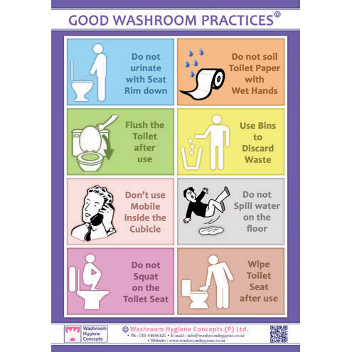

Slide 8
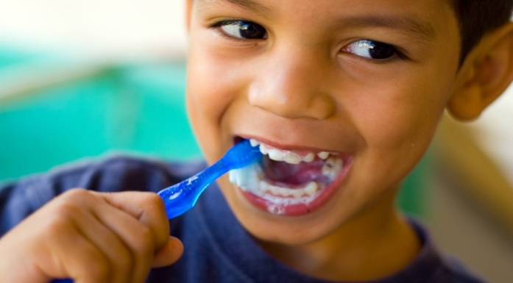
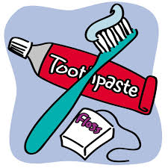
Dental Hygiene
Stop Bad Breath
Brush teeth twice a day
Flossing after every brushing or after every meal
Use a tongue cleaner
Tooth decay (Cavities)
Encourage children to have regular meals
Avoid snacking
Ask dentist about fluoride toothpaste and sealants

Slide 9
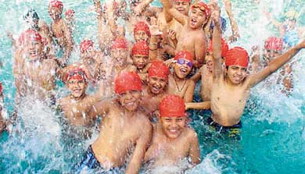
Swimming Hygiene
Don't dirty water
Stay out of the water if you have diarrhoea
Shower before you get in the water
Dont pee or poop in the water
Dont swallow the water
Every hour -------- Everyone out
Take kids on bathroom breaks
Check diapers

Slide 10
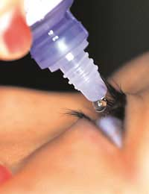
Eye Hygiene
Conjunctivitis
Signs & Symptoms : Redness, bloodshot eyes, swelling, soreness, discharge
Use warm water for cleaning with cotton or gauze pads swabbing from inside to outside edge
Every individual should have their own towel, which should be regularly washed and never shared

Slide 11
Hygiene Etiquette & Practice
Stop the spread of germs
Cover your mouth & nose with a tissue when you cough or sneeze
Put your used tissue in a waste basket
Avoid close contact with people who are sick

Slide 12
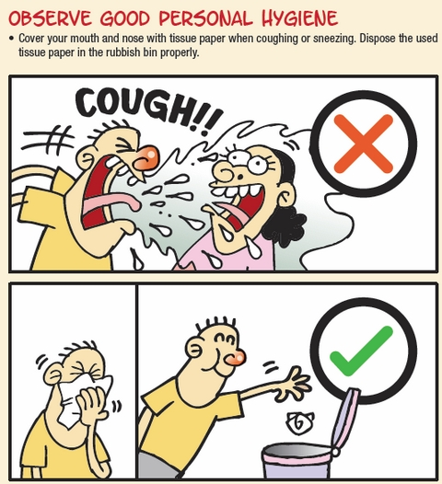

Slide 13
PRESENTATION
BY
Surg Cdr George Koshy
Station Health Officer

