Slide 1
“ EDUCATION IS THE ABILITY TO LISTEN TO ALMOST ANYTHING WITHOUT LOSING YOUR TEMPER OR YOUR
SELF-CONFIDENCE ”
Notes:
1
Respected _______________________ Ladies and Gentlemen it gives me immense pleasure to make a presentation in respect of Navy Children School, Visakhapatnam.

Slide 2

NAVY CHILDREN SCHOOL
VISAKHAPATNAM
ORIENTATION PROGRAMME
Class X
(2019-20)
Notes:
2
Respected _______________________ Ladies and Gentlemen it gives me immense pleasure to make a presentation in respect of Navy Children School, Visakhapatnam.

Slide 3
INTRODUCTION OF CLASS TEACHERS
NAUSENABAUGH
Class X (2019-20)
Notes:
3
Respected _______________________ Ladies and Gentlemen it gives me immense pleasure to make a presentation in respect of Navy Children School, Visakhapatnam.

Slide 4
INTRODUCTION OF CLASS TEACHERS
NSB
MRS. NIRMALA DEVI - CO-ORDINATOR
CLASS | CLASS TEACHER
X – E | MRS. SREELATHA NAIR

Slide 5
INTRODUCTION OF CLASS TEACHERS
104 AREA
MRS. Sharada - CO-ORDINATOR
CLASS | CLASS TEACHER
X – P | MR. SUBRAMANYAM
X – Q | MRS.UMA

Slide 6
CLASS X - ENGLISH TEACHER (NSB)
CLASS | ENGLISH
X – E | MRS. ROUMELIA

Slide 7
CLASS X- ENGLISH TEACHERS (104A)
CLASS | ENGLISH
X – P | MRS. SAILAJA
X – Q | MRS.UMA

Slide 8
CLASS X - HINDI TEACHER (NSB)
CLASS | HINDI
X – E | MRS. MADHUBALA K

Slide 9
CLASS X - HINDI TEACHERS (104A)
CLASS | HINDI
X – P | MR.ANIL
X – Q | MRS.MANISHA

Slide 10
CLASS X - SANSKRIT TEACHER (104A)
CLASS | SANSKRIT
X P & Q | MR. GANAPATI

Slide 11
CLASS X - MATHS TEACHER (NSB)
CLASS | MATHEMATICS
X – E | MRS. SREELATHA NAIR

Slide 12
CLASS X - MATHS TEACHERS (104A)
CLASS | MATHS
X – P | MR.SUBRAMANYAM
X – Q | MRS.CHAITANYA

Slide 13
CLASS X - SCIENCE TEACHERS (NSB)
CLASS | PHYSICS | CHEMISTRY | BIOLOGY
X – E | MRS. K. SRIVANI | MR. P.V.K. PRASAD | MRS. RITA MALVIYA

Slide 14
CLASS X (P&Q)- SCIENCE TEACHERS (104A)
SUBJECT | SCIENCE
PHYSICS | MRS.SUBHASHINI
CHEMISTRY | MRS.SUMITA
BIOLOGY | MRS.BHARATI

Slide 15
CLASS X - SOCIAL SCIENCE TEACHER
(NSB)
CLASS | SOCIAL SCIENCE
X – E | MRS. FARIDA PARVEEN ANSARI

Slide 16
CLASS X - SOCIAL SCIENCE TEACHERS
(104A)
CLASS | SOCIAL SCIENCE
X – P | MR.SARITA
X – Q | MRS.SHARADA

Slide 17
Classes will be conducted till 10th May 2019

Slide 18
REMODELLED ASSESSMENT STRUCTURE
FOR THE ACADEMIC YEAR 2019-20

Slide 19
INTERNAL ASSESSMENT (20 MARKS)
Periodic Test - 10 marks
Portfolio -5 marks
Subject Enrichment - 5 marks
student has to secure 33% out of overall 20 marks earmarked in each subject
BOARD EXAM student has to secure 33% (i.e. 27 marks) out of 80 marks in each subject

Slide 20
ASSESSMENT PATTERN
Pre – mid test : 40 Marks (Month of July 2019)
Mid term test : 80 marks(Month of Sep/Oct 2019)
Post mid test : 40 Marks (Month of Nov 2019)
Note: Average of the best two tests will be taken for final marks submission out of 10 marks)
Pre-Board – I : 80 marks(Month of Dec 2019)
Pre-Board – II (Common Pre-board): 80 marks(Month of Jan 2020)
Board Exam - 80 marks

Slide 21
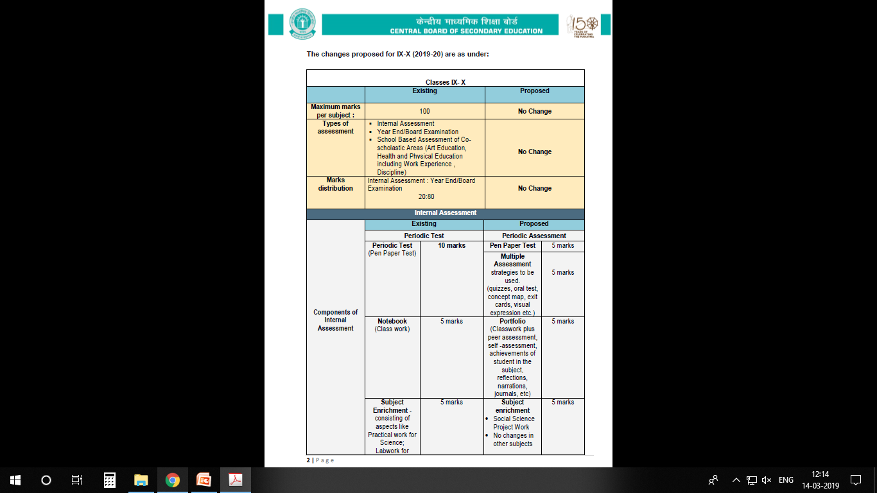

Slide 22
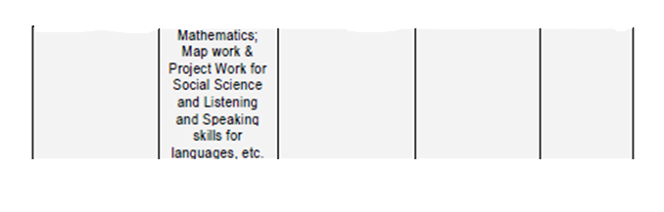

Slide 23
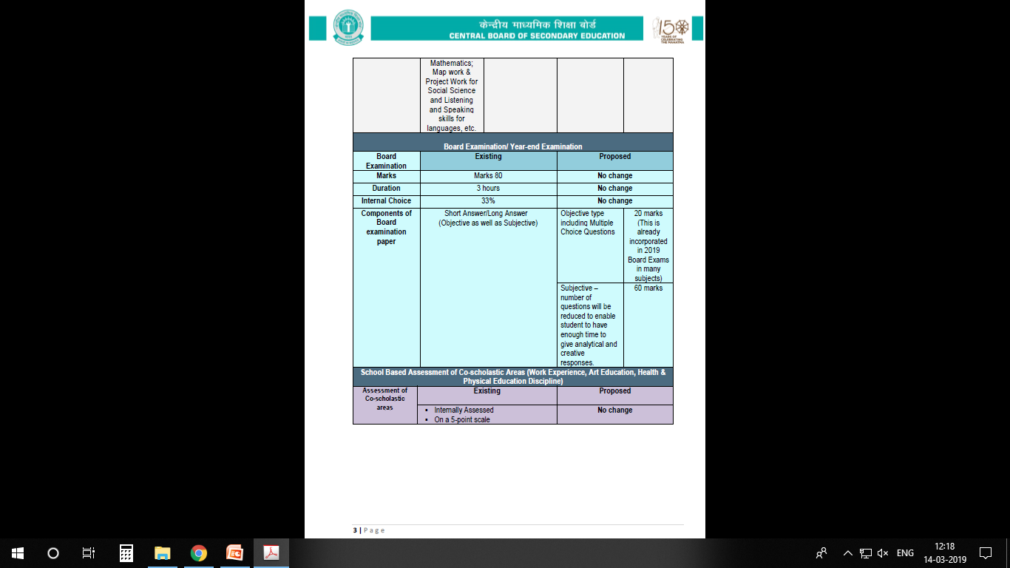

Slide 24
INTRODUCTION OF TWO LEVELS OF MATHEMATICS
The two levels of Examination will be held in the subject of Mathematics in the Board examination for Class X in the year 2020 and the same shall not be applicable to the internal assessment in class X.

Slide 25
INTRODUCTION OF TWO LEVELS OF MATHEMATICS
First level would be the same as the existing one, and the other would be an easier level.
The nomenclature for the two Examinations will be; Mathematics-Standard for the existing level of examination, and Mathematics-Basic for the easier level of examination

Slide 26
INTRODUCTION OF TWO LEVELS OF MATHEMATICS
The syllabus, class room teaching and internal assessment for both the levels of examination would remain the same; so that the students get an opportunity to study the whole range of topics throughout the year and are able to decide upon the level of Board examination depending upon their aptitude and abilities

Slide 27
INTRODUCTION OF TWO LEVELS OF MATHEMATICS
  The Standard level will be meant for students who wish to opt for Mathematics at Sr. Secondary level and the Basic level would be for students not keen to pursue Mathematics at higher levels

Slide 28
INTRODUCTION OF TWO LEVELS OF MATHEMATICS
  A student will have the right to choose between the two levels of Examination at the time of submission of List of Candidates (LOC) by the affiliated school to the Board online

Slide 29
INTRODUCTION OF TWO LEVELS OF MATHEMATICS
  In case student fails at any level of Mathematics, he/she can appear at the compartment examination as per norms of the Board according to the options Given below :
In case of failure in | Compartment options
Mathematics-Basic | Mathematics-Basic
Mathematics-Standard | Mathematics-Standard or Mathematics-Basic

Slide 30
INTRODUCTION OF TWO LEVELS OF MATHEMATICS
  A student who qualifies the Mathematics-Basic, shall be given an option to appear in Mathematics-Standard at the time of Compartment exams as per norms of the Board, in case he/she changes his/her mind to pursue Mathematics at Senior Secondary level.

Slide 31
2.Co-scholastic Areas
These activities will be graded on a 5 - Points Grading Scale (A to E) and will have no descriptive indicators. No up scaling of grades will be done.
The co-scholastic areas are as follows:
Work Education – Awarded by the concerned teacher
Art Education – Awarded by the concerned
teacher
Health & physical Education – By the Physical Education teacher.

Slide 32
3.Discipline
The students will also be assessed for the discipline which will be based on the factors like attendance, sincerity, behaviour, values, tidiness, respectfulness for rules and regulations, attitude towards society, Nation and others. Grading on Discipline will be done on a 5-point grading scale

Slide 33
GRADING SCALE
Marks and Grades both will be awarded for Individual subjects.
8-Point grading will be followed by the board. (A1, A2, B1, B2, C1, C2, D & E(Failed)

Slide 34
EXTRA CLASSES
  Apart from the extra classes conducted during summer vacation, School may also conduct extra classes whenever required with prior intimation to the students & parents .

Slide 35

PARENT TEACHER INTERACTION
PTI meetings will be conducted
according to school almanac after every examination.
Irrespective of the above, parents must meet teachers on any working Wednesday (1400 hrs – 1500 hrs) with prior intimation to the teacher.

Slide 36
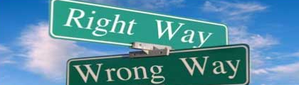
DISCIPLINE
The students are instructed not to indulge in any of the following. If they do so, their names will be entered in the Indiscipline Register & this will be informed to the parents on regular basis.
The following tantamounts to Indiscipline;
Teasing, ragging, abusing peer group (or) other class students.
Contd…

Slide 37
DISCIPLINE
Habitual late coming to school.
Intentional disturbance during the class.
Carrying electronic gadgets like mobiles, iPods, etc. & cash more than Rs.50/- (Without valid reason).
Incomplete class work.
Contd…

Slide 38
DISCIPLINE
Arrogant behaviour with students or teachers.
Stealing of money, note books, text books etc from other students.
Coming late to the class after break / P.T. / from other classes.
Not being in time for the assembly.
Non adherence to the rules of dispersal.

Slide 39
DISCIPLINE
Arrogant behaviour with students or teachers.
Stealing of money, note books, text books etc from other students.
Coming late to the class after break / P.T. / from other classes.
Not being in time for the assembly.
Non adherence to the rules of dispersal.

Slide 40
NOTE:
In case any change in the Address or Contact Number You are requested to inform the school

Slide 41
THANK YOU

