Slide 1
“ EDUCATION IS THE ABILITY TO LISTEN TO ALMOST ANYTHING WITHOUT LOSING YOUR TEMPER OR YOUR
SELF-CONFIDENCE ”
Notes:
1
Respected _______________________ Ladies and Gentlemen it gives me immense pleasure to make a presentation in respect of Navy Children School, Visakhapatnam.

Slide 2

NAVY CHILDREN SCHOOL
NAUSENABAUGH, VISAKHAPATNAM
ORIENTATION PROGRAMME
Class X
(2019-20)
Notes:
2
Respected _______________________ Ladies and Gentlemen it gives me immense pleasure to make a presentation in respect of Navy Children School, Visakhapatnam.

Slide 3
INTRODUCTION OF CLASS TEACHERS
NAUSENABAUGH
Class X (2019-20)
Notes:
3
Respected _______________________ Ladies and Gentlemen it gives me immense pleasure to make a presentation in respect of Navy Children School, Visakhapatnam.

Slide 4
INTRODUCTION OF CLASS TEACHERS
Mrs. NIRMALA DEVI - Co-Ordinator
X C – Mrs. K. SRIVANI
X D – Mrs. CH. NIRMALA DEVI

Slide 5
CLASS X - ENGLISH TEACHERS
CLASS | ENGLISH
X – C | MRS. V. GAURI
X – D | MRS. ARUNDHATI

Slide 6
CLASS X - HINDI TEACHERS
CLASS | HINDI
X – C | MR. V. SAI KRISHNA
X – D | MRS. CH. NIRMALA DEVI

Slide 7
CLASS X - MATHS TEACHERS
CLASS | MATHEMATICS
X – C | MR. K. SRINIVASA RAO
X – D | MR. M. APPALA RAJU

Slide 8
CLASS X - SCIENCE TEACHERS
CLASS | PHYSICS | CHEMISTRY | BIOLOGY
X – C | MRS. K. SRIVANI | MR. P.V.K. PRASAD | MRS. RITA MALVIYA
X – D | MRS. DEEPTHI VARMA | MR. P.V.K. PRASAD | MRS. S. SUHASINI

Slide 9
CLASS X - SOCIAL SCIENCE TEACHERS
CLASS | SOCIAL SCIENCE
X – C | MR. APPA RAO REDDY
X – D | MR. APPA RAO REDDY

Slide 10
Classes will be conducted till 10th May 2019

Slide 11
REMODELLED ASSESSMENT STRUCTURE
FOR THE ACADEMIC YEAR 2019-20

Slide 12
INTERNAL ASSESSMENT (20 MARKS)
Periodic Test - 10 marks
Portfolio -5 marks
Subject Enrichment - 5 marks
student has to secure 33% out of overall 20 marks earmarked in each subject
BOARD EXAM student has to secure 33% (i.e. 27 marks) out of 80 marks in each subject

Slide 13
ASSESSMENT PATTERN
Pre – mid test : 40 Marks (Month of July 2019)
Mid term test : 80 marks(Month of Sep/Oct 2019)
Post mid test : 40 Marks (Month of Nov 2019)
Note: Average of the best two tests will be taken for final marks submission out of 10 marks)
Pre-Board – I : 80 marks(Month of Dec 2019)
Pre-Board – II (Common Pre-board): 80 marks(Month of Jan 2020)
Board Exam - 80 marks

Slide 14
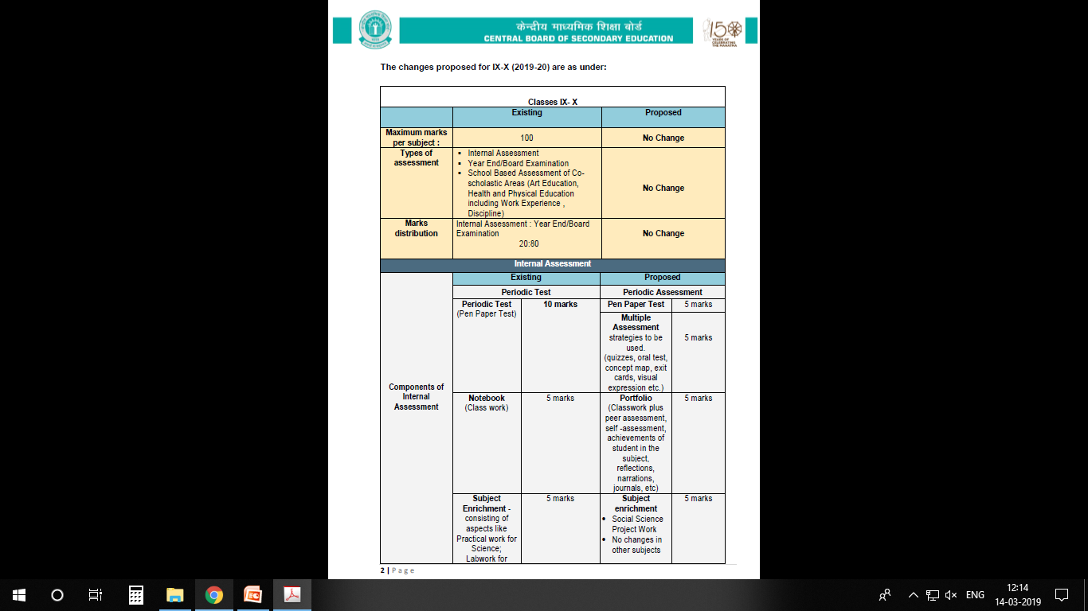

Slide 15
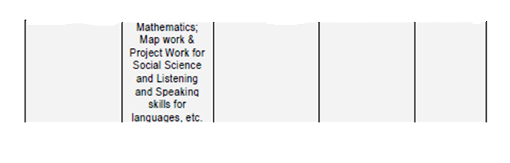

Slide 16
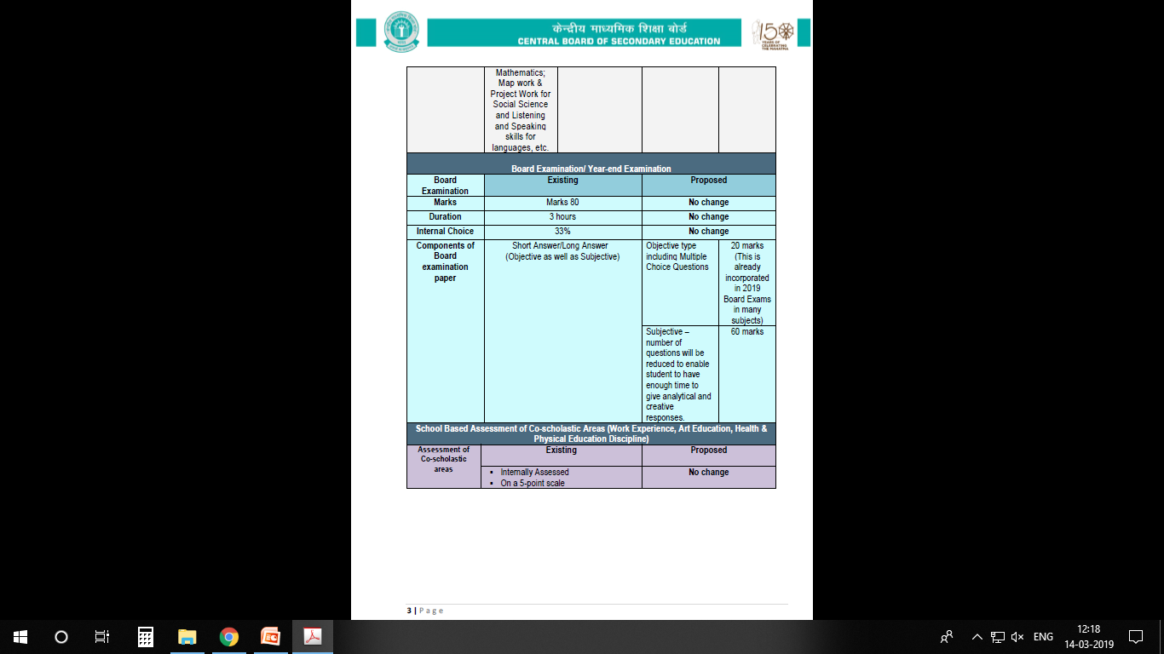

Slide 17
INTRODUCTION OF TWO LEVELS OF MATHEMATICS
The two levels of Examination will be held in the subject of Mathematics in the Board examination for Class X in the year 2020 and the same shall not be applicable to the internal assessment in class X.

Slide 18
INTRODUCTION OF TWO LEVELS OF MATHEMATICS
First level would be the same as the existing one, and the other would be an easier level.
The nomenclature for the two Examinations will be; Mathematics-Standard for the existing level of examination, and Mathematics-Basic for the easier level of examination

Slide 19
INTRODUCTION OF TWO LEVELS OF MATHEMATICS
The syllabus, class room teaching and internal assessment for both the levels of examination would remain the same; so that the students get an opportunity to study the whole range of topics throughout the year and are able to decide upon the level of Board examination depending upon their aptitude and abilities

Slide 20
INTRODUCTION OF TWO LEVELS OF MATHEMATICS
  The Standard level will be meant for students who wish to opt for Mathematics at Sr. Secondary level and the Basic level would be for students not keen to pursue Mathematics at higher levels

Slide 21
INTRODUCTION OF TWO LEVELS OF MATHEMATICS
  A student will have the right to choose between the two levels of Examination at the time of submission of List of Candidates (LOC) by the affiliated school to the Board online

Slide 22
INTRODUCTION OF TWO LEVELS OF MATHEMATICS
  In case student fails at any level of Mathematics, he/she can appear at the compartment examination as per norms of the Board according to the options Given below :
In case of failure in | Compartment options
Mathematics-Basic | Mathematics-Basic
Mathematics-Standard | Mathematics-Standard or Mathematics-Basic

Slide 23
INTRODUCTION OF TWO LEVELS OF MATHEMATICS
  A student who qualifies the Mathematics-Basic, shall be given an option to appear in Mathematics-Standard at the time of Compartment exams as per norms of the Board, in case he/she changes his/her mind to pursue Mathematics at Senior Secondary level.

Slide 24
2.Co-scholastic Areas
These activities will be graded on a 5 - Points Grading Scale (A to E) and will have no descriptive indicators. No up scaling of grades will be done.
The co-scholastic areas are as follows:
Work Education – Awarded by the concerned teacher
Art Education – Awarded by the concerned
teacher
Health & physical Education – By the Physical Education teacher.

Slide 25
3.Discipline
The students will also be assessed for the discipline which will be based on the factors like attendance, sincerity, behaviour, values, tidiness, respectfulness for rules and regulations, attitude towards society, Nation and others. Grading on Discipline will be done on a 5-point grading scale

Slide 26
GRADING SCALE
Marks and Grades both will be awarded for Individual subjects.
8-Point grading will be followed by the board. (A1, A2, B1, B2, C1, C2, D & E(Failed)

Slide 27
EXTRA CLASSES
  Apart from the extra classes conducted during summer vacation, School may also conduct extra classes whenever required with prior intimation to the students & parents .

Slide 28

PARENT TEACHER INTERACTION
PTI meetings will be conducted
according to school almanac after every examination.
Irrespective of the above, parents must meet teachers on any working Wednesday (1400 hrs – 1500 hrs) with prior intimation to the teacher.

Slide 29

DISCIPLINE
The students are instructed not to indulge in any of the following. If they do so, their names will be entered in the Indiscipline Register & this will be informed to the parents on regular basis.
The following tantamounts to Indiscipline;
Teasing, ragging, abusing peer group (or) other class students.
Contd…

Slide 30
DISCIPLINE
Habitual late coming to school.
Intentional disturbance during the class.
Carrying electronic gadgets like mobiles, iPods, etc. & cash more than Rs.50/- (Without valid reason).
Incomplete class work.
Contd…

Slide 31
DISCIPLINE
Arrogant behaviour with students or teachers.
Stealing of money, note books, text books etc from other students.
Coming late to the class after break / P.T. / from other classes.
Not being in time for the assembly.
Non adherence to the rules of dispersal.

Slide 32
DISCIPLINE
Arrogant behaviour with students or teachers.
Stealing of money, note books, text books etc from other students.
Coming late to the class after break / P.T. / from other classes.
Not being in time for the assembly.
Non adherence to the rules of dispersal.

Slide 33
NOTE:
In case any change in the Address or Contact Number You are requested to inform the school

Slide 34
THANK YOU

