Slide 1
NAVY CHILDREN SCHOOL
VISAKHAPATNAM

Slide 3
ORIENTATION PROGRAMME
To
Class XII
(2019-20)

Slide 4
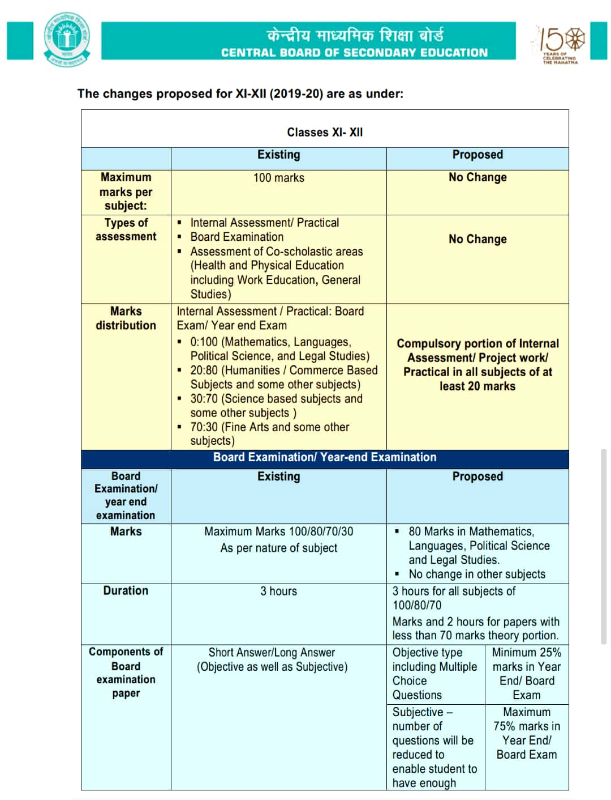

Slide 5
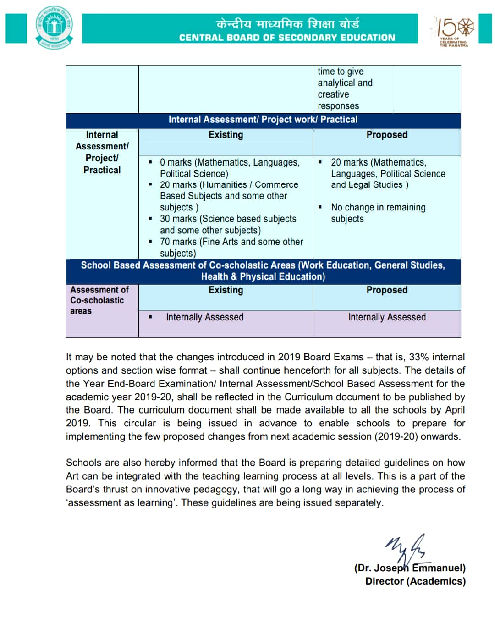

Slide 6
XII COORDINATOR
MS.RENUKA TOMAR

Slide 7
INTRODUCTION OF CLASS TEACHERS
XII A (Science) Dr. Nandana Khare
XII B (Science) Mr Satya Prasad
XII C (Science) Mrs. Y. Sailaja
XII D (Commerce) Ms. Renuka Tomar
XII E (Humanities) Mrs Jyothi Rani

Slide 8
INTRODUCTION OF SUBJECT TEACHERS
(Science Stream)
Name of the Teacher | Subject | Mobile No. | Suggested Refreshers
Mrs. Y. Sailaja Mrs. Jyoti Rani | English | 9966175192 8500387183 | -
Mrs. V S Eshwari Mrs. Kalyani Hari | Physics | 9491758552 9701754765 | S L Arora, Dinesh
Dr. Nandana Khare | Chemistry | 9757338286 | Modern’s ABC Dinesh
Mr. T. Satyaprasad | Mathematics | 9000683197 | R.D. Sharma
Mr. A. Srinivasa Rao | Biology | 9949152605 | Together with/ Arihant
Mr. Mukesh Bohra | Computer Sci. | 9989154240 | Move Fast / Arihant
Mr. V R Prasad | Physical Edu. | 9000089036 | Evergreen
Mrs. Ragini Mishra | Economics | 9346556610 | Sandeep Garg
Dr. G.K. Beatress | Psychology | 9849466477 | -

Slide 9
INTRODUCTION OF SUBJECT TEACHERS
(Commerce Stream)
Name of the Teacher | Subject | Mobile No. | Suggested Refreshers
Mrs. Y. Sailaja | English | 9966175192 | -
Ms. Renuka Tomar | Accountancy & Business Studies | 8500359858 | Comprehensive, TS Grewal Poonam Gandhi
Mrs. Ragini Mishra | Economics | 9346556610 | Sandeep Garg
Mr. Mukesh Bohra | I.P. | 9989154240 | Arihant
Mr. V R Prasad | Physical Edu. | 9000089036 | Evergreen
Mr. T. Satyaprasad | Mathematics | 9000683197 | R.D. Sharma
Dr. G.K. Beatress | Psychology | 9849466477 | -

Slide 10
INTRODUCTION OF SUBJECT TEACHERS
(Humanities Stream)
Name of the Teacher | Subject | Mobile No. | Suggested Refreshers
Mrs. Jyoti Rani | English | 8500387183 | -
Dr. G.K. Beatress | Psychology | 9849466477 | -
Mrs.Nalini Rani | Political Science | 9440605234 | Full Marks
Mrs. Ragini Mishra | Economics | 9346556610 | Sandeep Garg
Mr. Mukesh Bohra | I.P | 9989154240 | Arihant
Mr. V R Prasad | Physical Edu. | 9000089036 | Evergreen
Mrs.Ramneek Singh | Geography | 8331889432 | -
Mrs. Farida Parveen | History | 9130706704 | -
Mr. T. Satyaprasad | Mathematics | 9000683197 | R.D. Sharma

Slide 11
EXAMINATION SYSTEM
Unit Test-I (July’19)
Half Yearly Examination
(Sept’19)
Unit Test-II – (Nov’19)
Internal Pre-Board Exam
(Dec’19)
NES Common Pre-Board Examination
(Jan’20)

Slide 12
SYLLABUS COMPLETION &
PRE-BOARD EXAMINATION
Syllabus completion date for all Subjects both theory and practical is 05th November 2019.
The Internal Pre Board Examination will be held tentatively in the month of Dec 2019.
The NES Common Pre Board Examination will be starting from the 1st week of January 2020.
The Board Practical Examination will be held during the last week of January / 1st week of February 2020 tentatively.

Slide 13
PTI
PTI meetings will be conducted according to school almanac after every Examination.
Irrespective of the above, parents can meet teachers on any working Wednesdays (1400hrs – 1500hrs) with prior intimation to the teacher.

Slide 14
EXTRA CLASSES
Apart from the extra classes conducted during summer vacation, School may also conduct extra classes whenever required during other vacations / holidays with prior intimation to the students & parents through Teno app.

Slide 15
STUDENTS DISCIPLINE
The students are instructed that they should not indulge in any of the following. If they do so, their names will be entered in the Discipline Register & this will be informed to the parents on regular basis.
Criteria Points:
Teasing, ragging, abusing of peer group (or) other class students.
Habitual late coming to school.
Intentional disturbance during the class.
Carrying electronic gadgets like mobiles, iPods, etc. & cash more than Rs.50/-(Without valid reason).
Incomplete class work.
Contd…

Slide 16
STUDENTS DISCIPLINE
Arrogant behavior with students or teachers.
Stealing of money, note books, text books etc from other students.
Coming late to the class after break / P.T. / from other classes.
Not being in time for the assembly.
No adherence to the rules of dispersal.
Unnecessary argument with teachers.
Improper uniform and hair style.
Tampering marks allotted by the teacher.
Any other disciplinary issues other than the above points mentioned.

Slide 17
CHANGE IN CONTACT DETAILS
Any change in phone numbers, address, or any other contact details should be brought to the notice of the Class Teacher and Office immediately.
The changes in the contact details should be informed in writing through a letter signed by the parent.

Slide 18
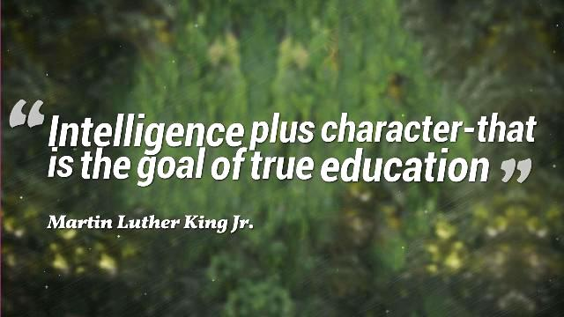
Thank You…

