Slide 1
National Education Foundation (NEF), Washington D.C. - USA’s Biggest Educational Non-Profit Organization
STEM Centre-of-Excellence (SCoE)TM at Naval Children School, Vizag

Slide 2
About NEF-USA and
State University of New York
(SUNY)
National Education Foundation (www.cyberlearning.org): NEF is USA’s biggest Non-Profit Organization HQ'ed out of Washington D.C. Founded in 1989, after consultations with national leaders including former President Bill Clinton and Intel founder Dr. Gordon Moore, NEF has the mission to bridge the employment, digital & academic skills divides by imparting high-quality, affordable STEM education to millions of students and jobseekers in countries including USA, India, Egypt, Jordan Mauritius etc. via it's blended-learning Program
SUNY@NY: State University of New York advocates the motto "To Learn-To Search-To Serve". Established in 1948, SUNY is the largest system of Public Institutions of Higher Education of USA and comprises of 64 different Universities and College Campuses across the State of New York with a cumulative enrollment of 1.3 M students, 88K faculties and an annual budget of US$ 10 Billion of which R&D alone constitutes US $ 1.3 Billion
SUNY’s oldest Campus@Potsdam - established in 1816, is aligned with NEF-USA as it’s Knowledge & Implementation Partner to deliver Grant-driven STEM Centre-of-Excellence Program for K12 segment
STEM Best-Practices NEF-USA is now deploying in Indian schools, already stands successfully implemented in 800+ schools across 15 States of USA (www.stemgrant.org; www.nefuniversity.org)
2

Slide 3
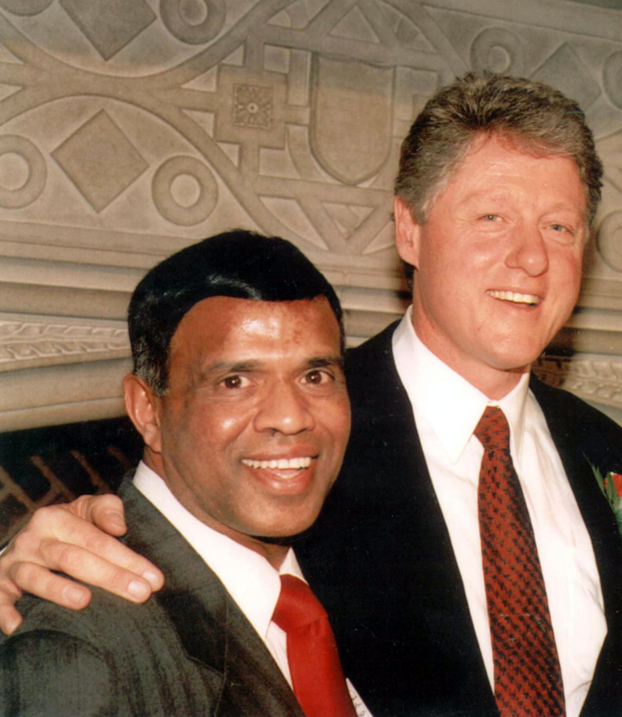
NEF (National Education Foundation) is the global non-profit leader in holistic, 80% Grant-based STEM education solutions
SUNY (State University of New York) is the largest public system of Universities in the State of New York
“You are helping to empower tomorrow's leaders. I salute you for your ongoing commitment for creating a better and stronger America”
- THE 42nd (ex)PRESIDENT OF USA BILL CLINTON ABOUT NEF FOUNDER & CHAIRMAN Dr. APPU KUTTAN
www.NEFUNIVERSITY.org

Slide 4
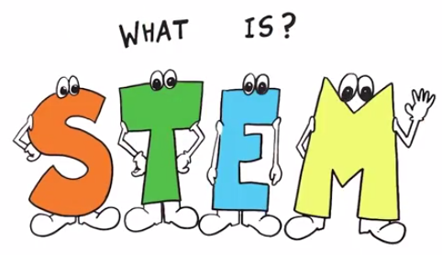
STEM = Science, Technology, Engineering & Mathematics
Science – Discover & Describe
Technology – Invent & Innovate
Engineering – Control, modify, or design materials, processes, and systems
Mathematics – Symbolic language to represent Real-life
CoE (Centre-of-Excellence) = Customized for India’s K-12 Requirements
www.stemgrant.org

Slide 5
STEM - Applications In Real-life
1. Which mathematical & engineering concepts are used in designing a parachute?
2. How is traffic movement in a smart-city controlled?
3.How can a UAV (drone) used in agricultural precision surveillance?
4. What is the basic physics & maths used while designing Robot’s arm movement?
5. How to avoid / defend against a cyber-attack?
6. Can there be a cheap, sustainable device to provide clean drinking water to our rural areas?
7. Can tomorrow’s electric cars be fuelled by water (H₂O)?
8. Can we reduce global warming by using excessive CO₂ present in atmosphere?
9. Can a nano-device be engineered to transport a precision-attack at (only) the cancerous cells of human body - to avoid harmful side-effects of chemotherapy?
10. Can a 3-D Printer be used to manufacture our body parts e.g.?
11. How does facial-recognition technology work for the security of public places?
12. Can cars “talk” to each other while on roads?
13. How can Gamification improve student competitiveness?
5

Slide 6
NEF’s Spectrum of STEM Education…
Integrates Science, Technology, Engineering, & Maths into an integrated learning experience
40-45% Program is Project-&-Activity based
Reinforces real-world application of Concepts Learnt
Prepares students for STEM careers
Develops Soft & Domain skills

Slide 7
NEF-USA: Credentials
LEADERS: A revolutionary approach to training have made us leaders in
Science,Technology,Engineering ,Mathematics(STEM)
Credit Transfer Courses for Autonomous Universities
21st-Centaury Employability Skills
NEF International Training: provides academic, digital, and workforce training to disadvantaged students and adults in many countries including India, Egypt, Jordan and Mauritius
Advisors to the White House (USA) on STEM Education
NEF-USA: Credentials in India
MoU’s with reputed Indian Public & Private Universities
National Skill Development Corporation (NSDC) under Prime Minister’s Skill-India Mission
MoU’s with State Governments like Tripura, Madhya Pradesh
SCoE is an Aspirational and Exclusive Program to be Implemented in 55 Select Schools in India (48 have already signed-up!)
Schools like DPS (9 selected by DPS Society), Shri Ram Schools, Sadhu Vaswani, Nirmal Bhartiya, Vijaybhoomi Int’l, Sri Venkateshwar Int’l, NCS@Chanakyapuri etc. have signed-up
Special Offer for Defense Schools: Grant enhanced to 90%

Slide 8
NEF-USA’s Motto: High Quality Education for All
NCS@Vizag and Today’s Globalized World
Change is the only Constant Today
Pace of Change in our dynamic world is both Swift & Unpredictable
NCS@Vizag prides itself with the fact that the school not only keeps abreast of the latest innovations in Education, but also believes in becoming trail-blazers in adopting pioneering ideas. STEM is one such idea……
In 2018, Naval Children Schools have decided to embrace STEM!
SCoE Program shall equip brilliant children of NCS with 21st-Century Skills needed to face tomorrow’s challenges w.r.t. a Tinkering & Investigative mind-set, real-world applications of concepts / theory learnt in classroom, Learning-from-failures, Problem-solving & Risk-taking skills, Coding-skills, Cyber-security awareness, Smart-city design, Engineering & design of Robots (Otto), Int’l business, Financial-literacy, Data-analysis, Leadership-&-Collaboration, (Written-&-Verbal) Communication skills and Health & Wellness

Slide 9
Introduction to STEM
Centre-of-Excellence (SCoE)
I. STEM Centre-of-Excellence (SCoE) Program is tailored around personalized-&-immersive learning to impart 21st Century Skills to school students. Though mapped to US STEM standards, SCoE is firmly anchored around CBSE/ICSE/IB syllabus. Currently, showcase CoE’s are being set-up in only 55 carefully-chosen schools across India
II. NEF-USA is on a mission to “Bridge the digital-&-skills divide of 1.0 Million learners in 2018”. We offer 90% Grant to Defense schools to implement SCoE. The Program follows Choice-based System (CBS) i.e. student may choose from a Level-appropriate Course combination. Each combo takes care of the inter-disciplinary nature of STEM incld. Domain and Soft-skills delivered in a Blended-Learning mode
III. Each school - across Classes 7th to 12th, can offer max. 240 students. 10% of students (girls and/or boys from financially-strained backgrounds) - selected by School Management, are offered 100% scholarship. Other (NCS) students pay a highly subsidized Fee of Rs. 2900 + 18% GST for this Program
IV. Program duration is 24 Hours per subject i.e. total 96 Hours and delivered at school’s premises for 7-to-8 Hrs. per alternate-weekend, across 6-months starting in Aug./Sep.’18 and ending in Dec.’18/Jan.’19
V. STEM Target Learner Streams: Science (PCB), Maths, Arts & Commerce
VI. Every Program participant gets a SUNY (State University of New York) and NSDC (National Skill Development Corporation) endorsed Certificate upon clearing the Final Assessment
9

Slide 10
STEM Program Features and
Benefits
A. High-Quality “De-Stresser”: SCoE is being exclusively deployed in 55 carefully-selected schools of India. Without losing the spirit of competition, NEF-USA’s STEM Program is a Knowledge-driven, stress-busting elevator to bring joyful learning as a counter to the “Exam-cracking” mindset of today’s schooling system. The delivery format is alternate-weekend based - without disturbing school’s academic Time-table
B. Curriculum: Within the ambit of CBSE/ICSE/IB curriculum, STEM unleashes a spirit of innovation, out-of-box creative-thinking and problem-solving skills via application of inter-disciplinary concepts leading to enhancement in Higher-Order Thinking Skills (HOTS) thereby scaling-up students’ knowledge by allowing them to commit mistakes while solving Project challenges
C. Pedagogy: Experiential learning with guidance-&-mentoring on STEM subjects by NEF experts - trained & certified by State University of New York (SUNY), guiding students to pursue STEM pathways & Courses in specific areas which may be chosen (in future) by participants at their Undergraduate levels. There is personalized learner tracking and 6 Weekly Reports are shared with teachers & parents
10

Slide 11
STEM Program Features and
Benefits
D. Program is Application-oriented: 40-45% of the entire Program is Project, Application & Activity based
E. 2-days Field Work: In a STEM-related Industry with prior preparation for application of knowledge acquired during STEM sessions
F. Facilitating International Education: NEF would impart Application Skills that shall translate into 3 credits points offered by SUNY@Potsdam for students of Class 10-&-above who qualify the post-Program Assessment. These credits help students get admission in foreign Universities
G. Project-based Learning: Students are engaged in STEM Projects & Design Contests viz. Smart-city Planning, Digital Security, Programing, Analytics, Project-Management, UAV-based Agricultural Surveillance, Climate-change / Global-Warming etc.
H. Blended Learning: Students are exposed to virtual / eLearning content and Gamification
I. International and Industry Exposure: Workshops conducted by industry and academic experts sourced from renowned organizations e.g. IBM/SAP/Google, SUNY@Potsdam, IISc., IITs, IIMs etc.
11

Slide 12
STEM Program Features and
Benefits
J. Building Communication-&-Leadership Skills and Spirit of Entrepreneurship-&-Collaboration: Such vital life-skills are the Program’s outcome. Students get into habit of writing Reports, give Presentations/Seminars. This elevates their confidence levels, besides instilling spirit of leadership and team-work.
K. Teacher-&-Parent Empowerment: STEM Program is launched with a 1 or 1.5-day STEM PD (Professional Development) Workshop organized for School teachers and delivered by NEF experts. School’s Director of SCoE Program is paid a decent monthly Honorarium. The Program includes a weekend Program designed for mothers (Home-Makers-to-Home-Shapers).
L. STEM Competitions: Motivational activities include display of Olympic Board at a prominent place in schools. Students’ participate in inter-school competitions leading to rewards/awards. Top-2 schools in the country shall be sponsored to participate in STEM Championship held annually at Washington D.C.
12

Slide 13
SCoE: Course Portfolio for India
Type-A | STEM Course Domain Skills Coverage | Type-B | STEM Course Soft-Skills Coverage
 | Topics' Bucket: Exposure to Science, Maths, Engineering & Technical Skills | 1 | Topics' Bucket: Exposure to Communication-&-Presentation Skills, Life-Management Skills, Critical-Thinking, Entrepreneurship-Leadership-&-Skills
1 | IT Specialization with Basics of Cyber-Security | 2 | Technical Presentation Skills, Body-language
2 | Project Management Skills (Basic) | 3 | Curiosity, Imagination and Entrepreneurship
3 | Data Analytics | 4 | Risk-taking
4 | Economics with Financial Literacy | 5 | Tinkering mindset, Making Mistakes and Learnings
5 | Economics with Financial Literacy & Credit Recovery | 6 | Collaboration, Time-management & Team-work
6 | Foundation of Programming | 7 | Personal Health, Fitness & Wellness; Mind-Body-&-Soul
7 | Algebra and Financial Analytics | 8 | Life Management Skills
8 | Calculus - As Applied in Technology | 9 | Critical-thinking skills
9 | International Business Skills | 10 | Problem Solving & Learning Strategies
10 | Science-based Problem Solving Skills and Learning Strategies | 11 | Program for students & mothers ("Home-Maker-to-Home-Shaper")
11 | UAVs in Precision Agricultural Surveillance | 12 | Etc.
12 | Smart-cities | 13
13 | Application of Science & Maths in Daily Life | 14
14 | Etc. | 15
15 |  | 16
www.stemgrant.org

Slide 14
THANK YOU

