Slide 1
“ EDUCATION IS THE ABILITY TO LISTEN TO ALMOST ANYTHING WITHOUT LOSING YOUR TEMPER OR YOUR
SELF-CONFIDENCE ”
Notes:
1
Respected _______________________ Ladies and Gentlemen it gives me immense pleasure to make a presentation in respect of Navy Children School, Visakhapatnam.

Slide 2

NAVY CHILDREN SCHOOL
NAUSENABAUGH, VISAKHAPATNAM
ORIENTATION PROGRAMME
Class VII
(2019-2020)
Notes:
2
Respected _______________________ Ladies and Gentlemen it gives me immense pleasure to make a presentation in respect of Navy Children School, Visakhapatnam.

Slide 3
INTRODUCTION OF CLASS TEACHERS
NAUSENABAUGH
Class VII (2019-20)
Notes:
3
Respected _______________________ Ladies and Gentlemen it gives me immense pleasure to make a presentation in respect of Navy Children School, Visakhapatnam.

Slide 4
INTRODUCTION OF CLASS TEACHERS
Mrs. R. SREELAKSHMI - Co-Ordinator
VII A – Dr. POONAM K
VII B – MRS. P DEEPTI MAHENDRA
VII C – MRS. ARUNDHATI CHOUDHURY
VII D – MRS. CH. SOWJANYA
VII E – Mrs. R. SREELAKSHMI
VII F – MRS. R V S VINATHA

Slide 5
CLASS VII - ENGLISH TEACHERS
CLASS | ENGLISH
VII – A | MRS. D SUNITA
VII – B | MRS. ARUNDHATI CHOUDHURY
VII – C | MRS. ARUNDHATI CHOUDHURY
VII – D | MRS. SREELAKSHMI
VII – E | MRS. SREELAKSHMI
VII – F | MRS. SREELAKSHMI

Slide 6
CLASS VII - HINDI TEACHERS
CLASS | HINDI
VII – A | Dr. POONAM K
VII – B | MRS. URMILA
VII – C | Dr. POONAM K
VII – D | MRS. URMILA
VII – E | Dr. POONAM K
VII – F | MRS. URMILA

Slide 7
CLASS VII - SANSKRIT TEACHERS
CLASS | SANSKRIT
VII | MRS. BEENA RAJPUT

Slide 8
CLASS VII - MATHS TEACHERS
CLASS | MATHEMATICS
VII – A | MRS. SARITA AJITH
VII – B | MR. BHUVAN
VII – C | MR. BHUVAN
VII – D | MRS. SARITA AJITH
VII – E | MR. VEERA BABU
VII – F | MRS. VINATHA

Slide 9
CLASS VII - SCIENCE TEACHERS
CLASS | SCIENCE
VII – A | MRS. P DEEPTHI MAHENDRA
VII – B | MRS. P DEEPTHI MAHENDRA
VII – C | MR. A. SRINIVAS
VII – D | MRS. CH. SOWJANYA
VII – E | MRS. CH. SOWJANYA
VII – F | MR. A. SRINIVAS

Slide 10
CLASS VII - SOCIAL SCIENCE TEACHERS
CLASS | SOCIAL SCIENCE
VII – A | MRS. LAKSHMI KANTHAM
VII – B | MRS. LAKSHMI KANTHAM
VII – C | MR. GANGULU
VII – D | MRS. ARUNALATHA
VII – E | MR. GANGULU
VII – F | MR. SANJEEV KUMAR

Slide 11
CLASS VII – CO-SCHOLASTIC TEACHERS
SUBJECT | NAME OF THE TEAHCER
WORK EDUCATION | MR. SATTI BABU
COMPUTERS | MRS. UJWALA
LIBRARY | MRS. ANURADHA P
PHYSICAL EDUCATION | MR. L V RAMANA & MR. SANJAY
YOGA | Dr B. SATYAVANI
ART | MR. RAMAKRISHNA
MUSIC | MR. KRISHNA

Slide 12
REMODELLED ASSESSMENT STRUCTURE
FOR THE ACADEMIC YEAR 2019-20

Slide 13
INTERNAL ASSESSMENT (20 MARKS)
Periodic Test - 10 marks
Portfolio - 5 marks
Subject Enrichment - 5 marks
student has to secure 33% out of overall 20 marks earmarked in each subject
ANNUAL EXAM student has to secure 33% (i.e. 27 marks) out of 80 marks in each subject

Slide 14
ASSESSMENT PATTERN
Pre – mid test : 40 Marks (Month of July 2019)
Mid term test : 80 marks(Month of Sep/Oct 2019)
Post mid test : 40 Marks (Month of Nov 2019)
Note: Average of the best two tests will be taken for final marks submission out of 10 marks)
Annual examination : 80 Marks (Month of Mar 2020)

Slide 15
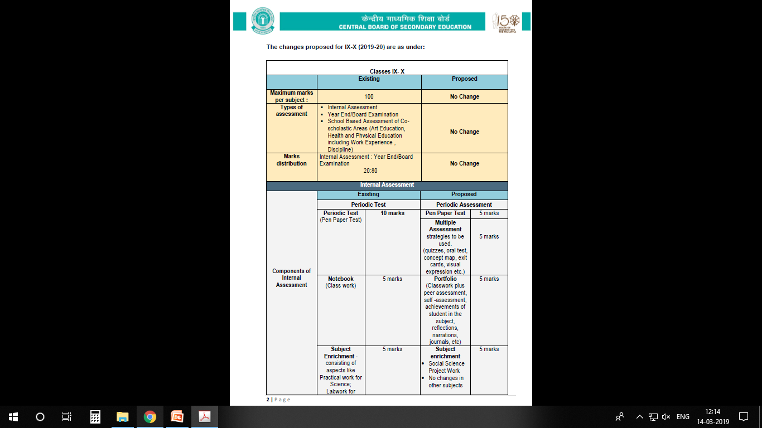
CLASS VII

Slide 16


Slide 17
2.Co-scholastic Areas
These activities will be graded on a 3 - Points Grading Scale (A to C) and will have no descriptive indicators. No up scaling of grades will be done.
The co-scholastic areas are as follows:
Work Education – Awarded by the concerned teacher
Art Education – Awarded by the concerned
teacher
Health & physical Education – By the Physical Education teacher.

Slide 18
3.Discipline
The students will also be assessed for the discipline which will be based on the factors like attendance, sincerity, behaviour, values, tidiness, respectfulness for rules and regulations, attitude towards society, Nation and others. Grading on Discipline will be done on a 5-point grading scale

Slide 19
GRADING SCALE
Marks and Grades both will be awarded for Individual subjects.
8-Point grading will be followed by the board. (A1, A2, B1, B2, C1, C2, D & E(Needs Improvement)

Slide 20

PARENT TEACHER INTERACTION
PTI meetings will be conducted
according to school almanac after every examination.
Irrespective of the above, parents must meet teachers on any working Wednesday (1400 hrs – 1500 hrs) with prior intimation to the teacher.

Slide 21
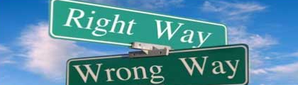
DISCIPLINE
The students are instructed not to indulge in any of the following. If they do so, their names will be entered in the Indiscipline Register & this will be informed to the parents on regular basis.
The following tantamounts to Indiscipline;
Teasing, ragging, abusing peer group (or) other class students.
Contd…

Slide 22
DISCIPLINE
Habitual late coming to school.
Intentional disturbance during the class.
Carrying electronic gadgets like mobiles, iPods, etc. & cash more than Rs.50/- (Without valid reason).
Incomplete class work.
Contd…

Slide 23
DISCIPLINE
Arrogant behaviour with students or teachers.
Stealing of money, note books, text books etc from other students.
Coming late to the class after break / P.T. / from other classes.
Not being in time for the assembly.
Non adherence to the rules of dispersal.

Slide 24
DISCIPLINE
Arrogant behaviour with students or teachers.
Stealing of money, note books, text books etc from other students.
Coming late to the class after break / P.T. / from other classes.
Not being in time for the assembly.
Non adherence to the rules of dispersal.

Slide 25
NOTE:
In case any change in the Address or Contact Number You are requested to inform the school

Slide 26
THANK YOU

